Slide 1


WEATHER ANALYTICS
DATA PIPELINE
Prachi Trivedi

Slide 2

Design Decisions
1
Three contrasting cities
2
Daily data, not hourly
San Francisco – coastal
Mesa – desert
Seattle — rainy
Deliberately different climates so the analytics reveal real contrast.
Pulled data at the level I analyze at
Hourly would be 24× the rows for no added value
3
Normalized schema
4
Forecast kept separate (retrieved_on)
Cities table
Daily records table ⟶ linked by foreign keys
No repeated city info
Keyed by WHEN the forecast was made
Historical facts don't change ⟶ no need for retrieval date

Slide 3
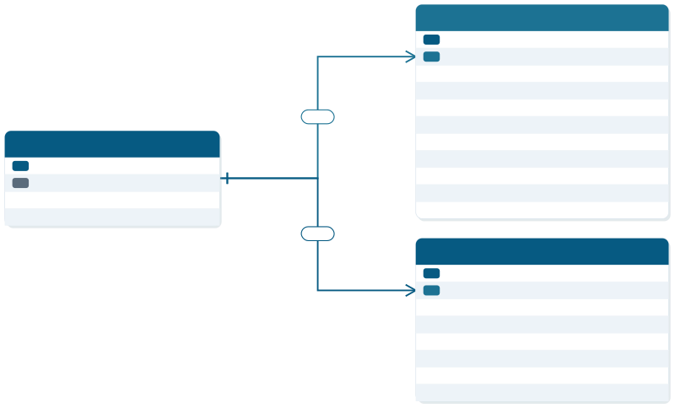


Database Schema
weather
PK FK
weather_id
city_id
serial
int
date numeric numeric numeric numeric numeric numeric timestamp timestamp
weather_date max_temp min_temp max_apparent_temp min_apparent_temp max_wind_speed precipitation
sunrise
sunset
1:N
cities
PK
city_id
serial varchar numeric numeric
city_name
longitude latitude
1:N
forecast
PK FK
forecast_id
city_id
serial
int
date
date numeric numeric timestamp timestamp
record_date retrieved_on max_temp precipitation sunrise sunset

Slide 4
The Pipeline
Extract
Clean
Load
Analyze
requests → raw JSON
pandas → cleaned CSV
psycopg → PostgreSQL
SQL → 7 queries

Slide 5
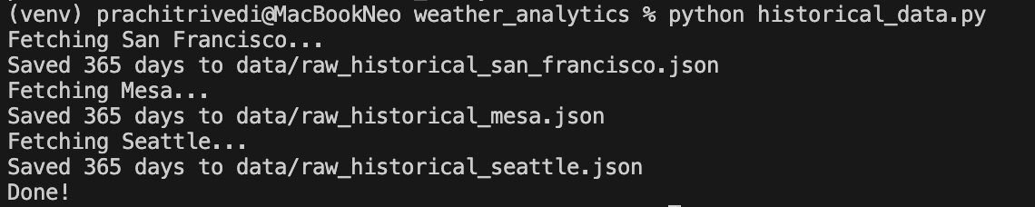
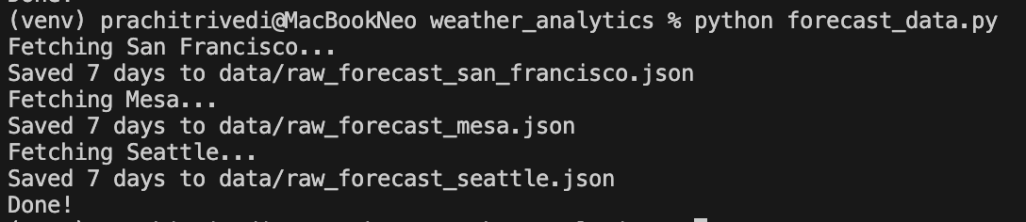
Extraction
Historical Data
Forecast Data

Slide 6
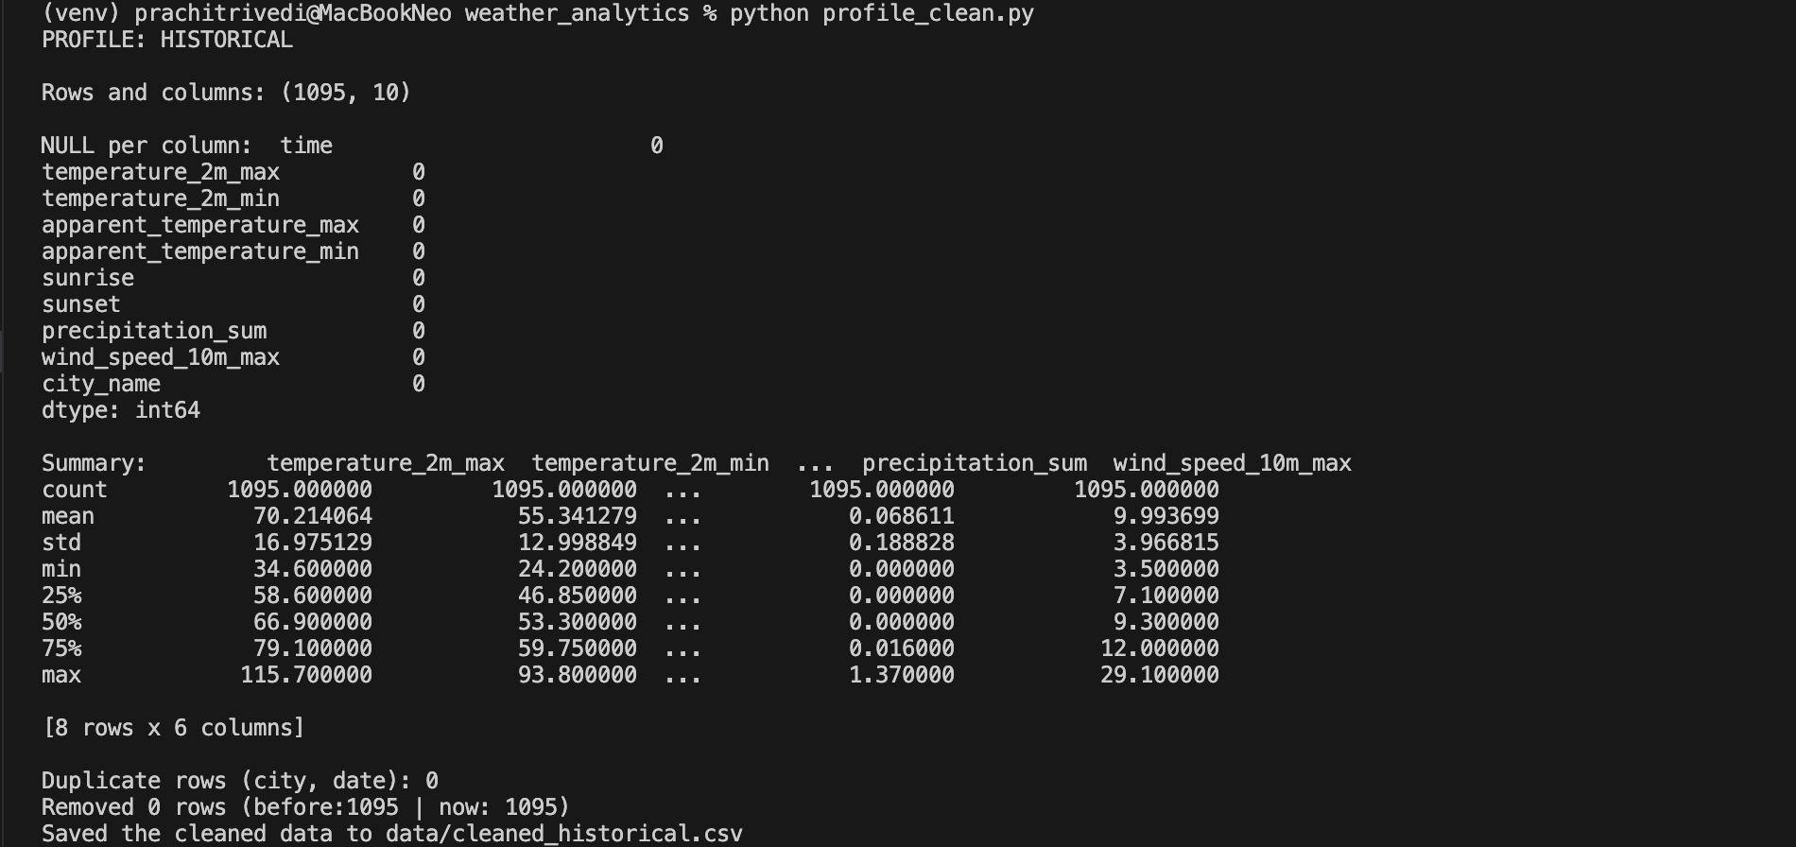
Profile + Clean (historical data)

Slide 7
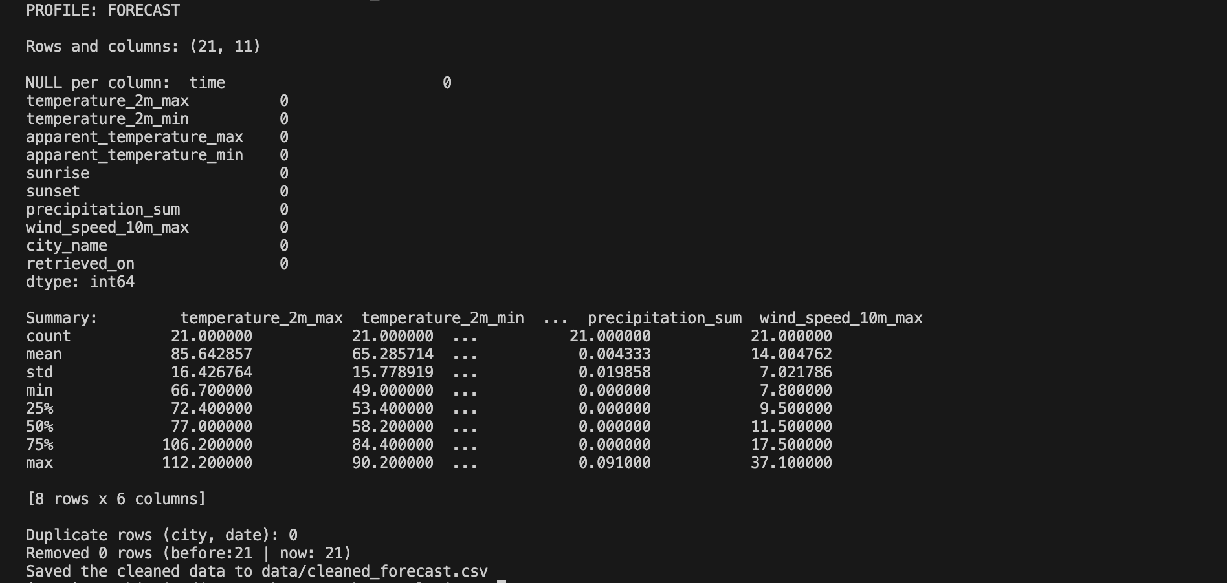
Profile + Clean (forecast data)

Slide 8
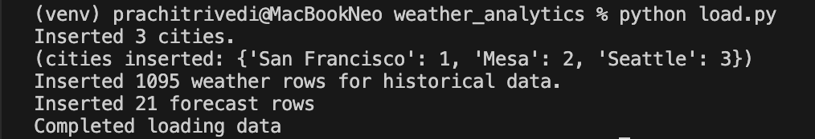
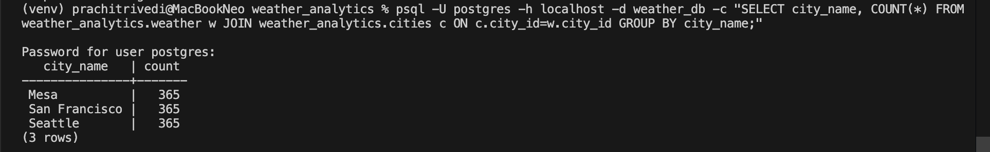
Extraction
psql -U postgres -h localhost -d weather_db -c "SELECT city_name, COUNT(*) FROM weather_analytics.weather w JOIN weather_analytics.cities c ON c.city_id = w.city_id GROUP BY city_name;"

Slide 9
Analyze (SQL Queries)
Highest temperature per city
Hottest month per city
Extreme heat & freezing days per city
Windiest week of the year
Average rainfall per city

